Slide 1
Machine Learning: Regression
Week 3: July 18th, 2022 - July 22th, 2022
[Source Code Link Here]

Slide 2
Bias of Models
Bias refers to the difference between the average prediction of our model and the correct value which we are trying to predict.
For example, linear regression assumes that there is a linear relationship between Y and X. It is unlikely that, in real life, the relationship is exactly linear so some bias will be present.
The more flexible/complex a model is the less bias it will generally have.
Model with high bias pays very little attention to the training data and oversimplifies the model. It always leads to high error on training and test data.

Slide 3
Variance of Models
Variance refers to the variability of model prediction for a given data point or a value which tells us spread of our data.
Generally, the more flexible a method is the more variance it has.
Model with high variance pays a lot of attention to training data and does not generalize on the data which it hasn’t seen before.

Slide 4
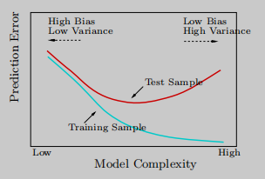
Bias-Variance Tradeoff of Models
As a method gets more complex the bias will decrease and the variance will increase.
In general, as the model complexity increases, training errors will always decline.
However, test errors will decline at first (as reductions in bias dominate) but will then start to increase again (as increases in variance dominate).
Read more about Bias-Variance Tradeoff here.
Fig 3.1 Bias-variance tradeoff graph (with train and test errors)

Slide 5
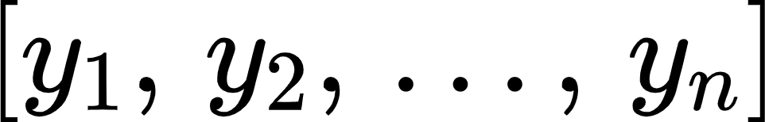
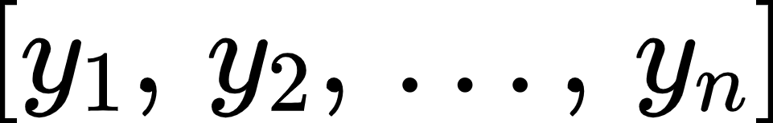
Independent and Identically Distributed (iid)
Let be a series of actual observations
If the knowledge of each observed value gives no information about the other observed values, then we say that the errors are independent.
If the probability distribution of an observation is the same as the distribution of other observations, then we would say that these events are identically distributed.
The iid Rules:
If the series of observations, , are iid, then the following rules apply:

Slide 6
Linear Regression - Use Cases
View correlations between any pair of assets
Calculate the hedge ratio between any pair of assets
Identification of significant factors that drive asset returns for better risk and performance management
Prediction of returns over various time horizons

Slide 7
Linear Regression - Assumptions
Assumes that the model is the result of a linear combination of the inputs
Assumes a random error that allows for each observation to deviate from the expected linear relationship
Assumes errors are known, and are independent and identically distributed (iid)
For a multiple regression, assume the independent variables are not too highly correlated with each other
Remarks:
These assumptions guarantee that the OLS method delivers estimates that are not only unbiased but also efficient (OLS method explained later)
These assumptions are rarely met in practice
Notes:
These assumptions guarantee that the OLS method delivers estimates that are not only unbiased but also efficient, which means that the OLS estimates achieve the lowest sampling error among all linear learning algorithms.
However, these assumptions are rarely met in practice

Slide 8
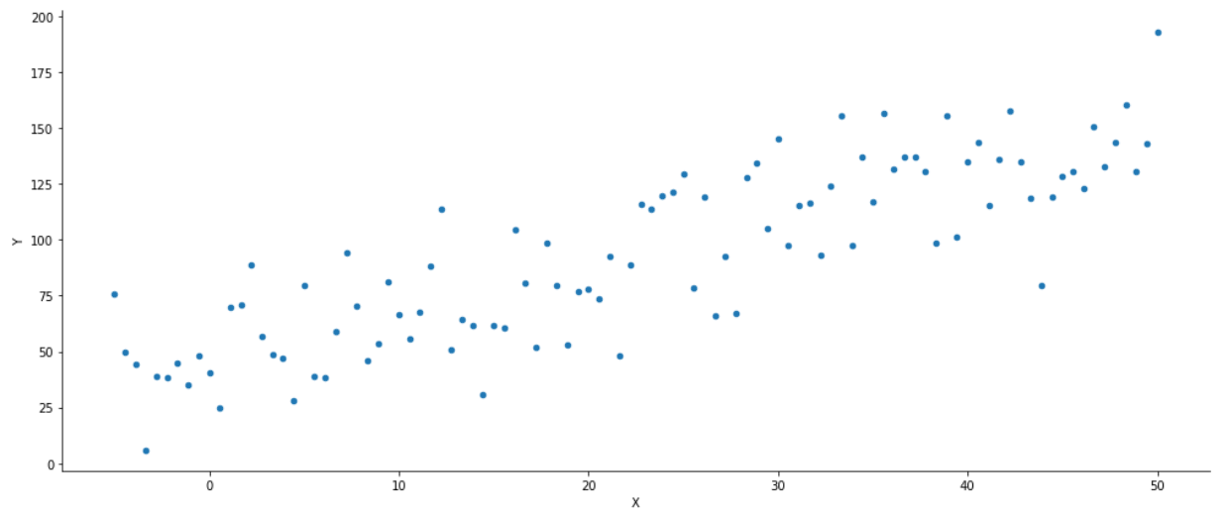
Suppose we got some simulated data…
How can we model the relationship between X and Y?
Fig 3.2.1 Randomly-generated data 2D

Slide 9
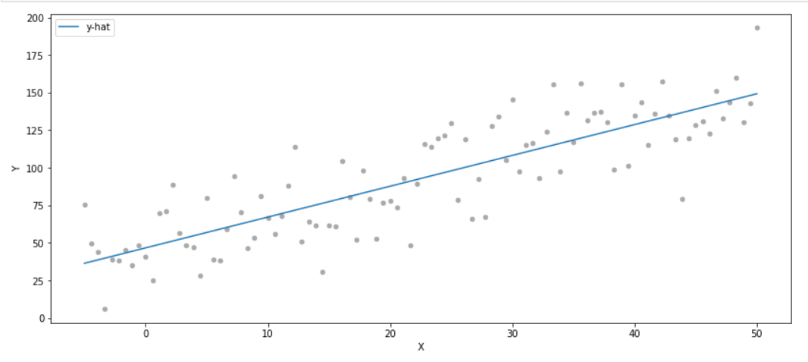
Suppose we got some simulated data…
Through a linear line which its function we can deduce. In other words, a simple linear regression.
Fig 3.2.1 Randomly-generated data 2D (with linear line)

Slide 10
How can we visually describe the model fit?
Fig 3.2.1 Randomly-generated data 2D (with linear line)
Direction: positive association between x and Y.
Linearity: a moderate to strong linear relationship is observed because a linear line can be fitted through the points.
Strength: a fairly strong relationship exists because the data points are close enough to surround the linear line.
Outliers: potential outliers are circled in red.
Clusters: no major clusters because all data points packed closely in one group.

Slide 11



Simple Linear Regression
The simple regression model defines a linear functional relationship between one continuous outcome variable and one input variable that takes on the following form:
But how do we know which and to chose?

Slide 12

Estimation Methods for and :
Ordinary Least Squares (OLS) - will cover
Maximum Likelihood Estimation (MLE) - will cover

Slide 13

Ordinary Least Squares (OLS)
The goal is to seek parameters that minimize the Residual Sum of Squares (RSS), sum of the squares of the difference between the model’s prediction and the actual outcome

Slide 14

Maximum Likelihood Estimation (MLE)
The goal is to seek parameters that maximize the likelihood function
Applicable whenever the probability distribution of the error terms is known

Slide 15

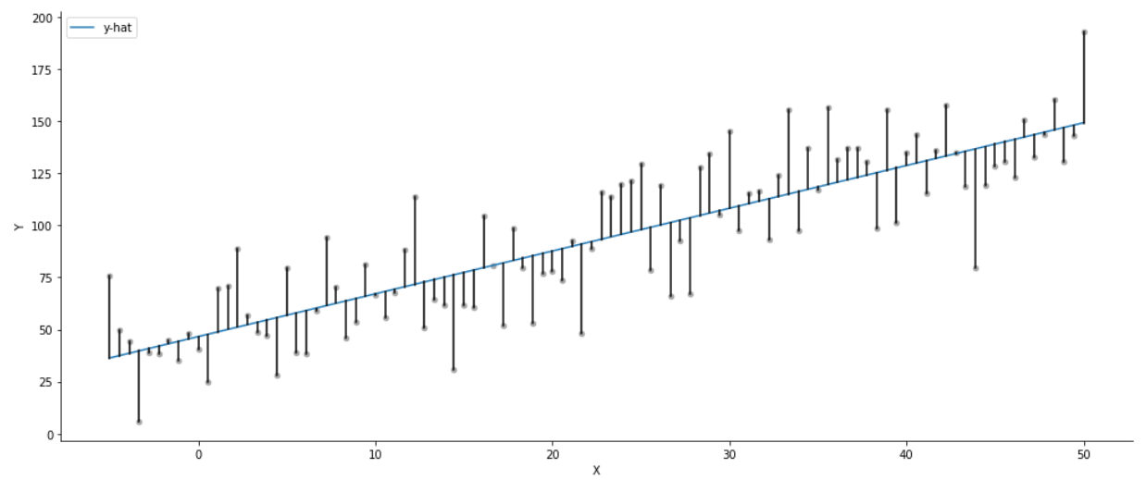
Fitting a Simple Linear Regression
Fig 3.2.3 Simple linear regression model fit

Slide 16
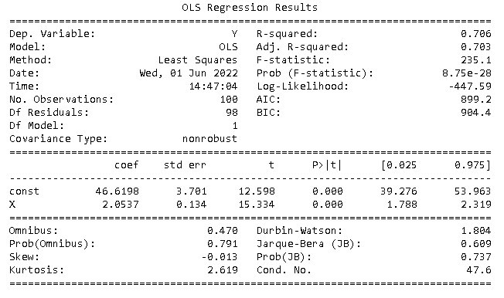
OLS Regression Result Summary
Fig 3.3 Simple linear regression model fit

Slide 17
OLS Regression Result Summary
Dataset Characteristics
Fig 3.3 Simple linear regression summary

Slide 18
OLS Regression Result Summary
Dataset Characteristics
Goodness of FIt
Fig 3.3 Simple linear regression summary

Slide 19
OLS Regression Result Summary
Dataset Characteristics
Goodness of FIt
Coefficient Values
Fig 3.3 Simple linear regression summary

Slide 20
OLS Regression Result Summary
Dataset Characteristics
Goodness of FIt
Coefficient Values
Residual Diagnostics
Fig 3.3 Simple linear regression summary

Slide 21
Model Diagnostics: t and F Tests
t-Test:
Used to determine whether an independent variable is significant in explaining the variance of the dependent variable.
F-Test:
Used to find the joint significance of multiple independent variables.
It can be used to compare two model’s ability to explain the variance of the dependent variable.
Prob (F-Statistic) tells you the accuracy of the null hypothesis, or whether it is accurate that your variables’ effect is 0.

Slide 22
Jarque-Bera (JB) Test
Determines whether or not sample data have skewness and kurtosis that matches a normal distribution.
Test statistic of the Jarque-Bera test is always a positive number and if it’s far from 0, it indicates that the sample data do not have a normal distribution.
Prob (JB)is the p-value of the test. It tells you whether there is significant consistency in having skewness and kurtosis zero of a normal distribution.
An alternative is the Omnibus test, which serves the same purpose.

Slide 23
Model Diagnostics: Durbin-Watson Test
A measurement of homoscedasticity, or an even distribution of errors throughout our data. Heteroscedasticity means an uneven distribution, for example as the data point grows higher the relative error grows higher.
The statistic will always range between 0 and 4. The Ideal homoscedasticity will lie between 1 and 2, with little to no autocorrelations.
Here is a table showing what each statistic value means and implies.
Durbin-Watson Statistic | Meaning | Implication
Between 0 and 2 (exclusive) | Positive autocorrelation | If an asset fell yesterday, it is also likely that it falls today.
2 | No autocorrelation | Whether an asset fell yesterday doesn’t imply any directional movement today.
Between 2 and 4 | Negative autocorrelation | If the asset fell yesterday, there is a greater likelihood it will rise today.

Slide 24
Model Diagnostics: Condition Number
A measurement of the sensitivity of our model as compared to the size of changes in the data it is analyzing.
Multicollinearity is strongly implied by a high condition number.
Again, multicollinearity describes two or more independent variables that are strongly related to each other and are falsely affecting our predicted variable by redundancy.
Just know that anything above 30 signifies significant multicollinearity.

Slide 25
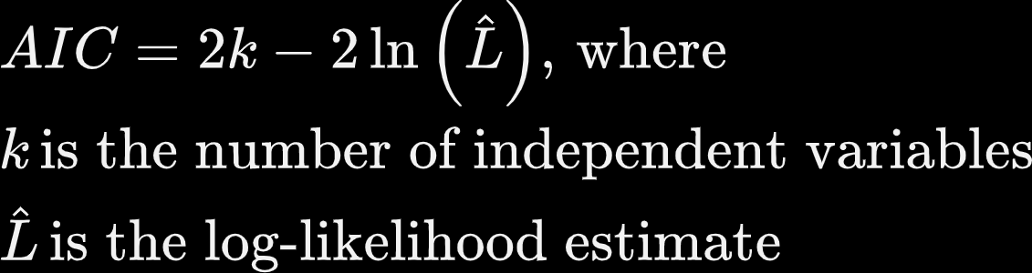
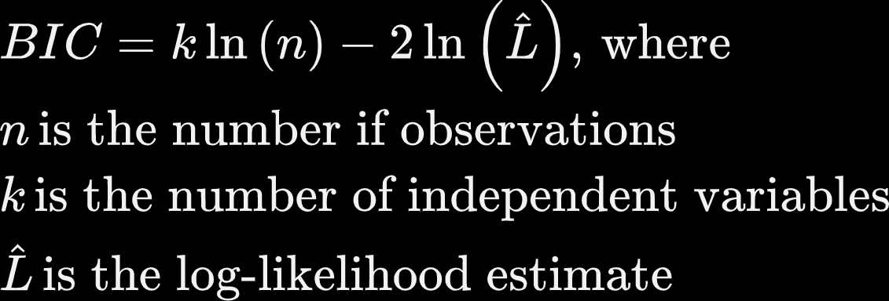
Model Diagnostics: Information Criteria
Used to compare the efficacy of models in the process of linear regression, using a penalty system for measuring multiple variables.
Akaike Information Criterion (AIC ):
Bayesian Information Criterion (BIC):
The lower the AIC and BIC values, the higher the efficacy of the model. So select the model with the lowest AIC and BIC values.

Slide 26
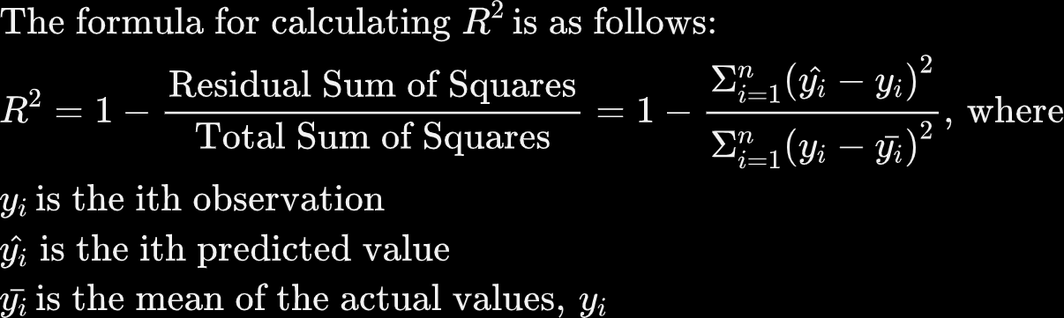
Model Evaluation: R-squared (Coefficient of Determination)
Measures the percentage of the prediction variable’s variation that is explained by a linear model. For instance, an R-squared of 0.338 would mean our model explains 33.8% of the change in our
For linear regression, R-squared ranges from 0 to 1 and is unitless.
The closer R² is to 1, the better the model explains all the variability of the target variable around its mean.

Slide 27
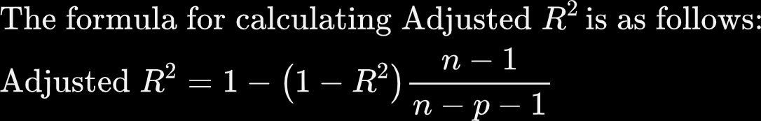
Model Evaluation: Adjusted R-squared
Your model’s R-squared value will never go down with additional variables, only equal or higher. Therefore, your model could look more accurate with multiple variables even if they are poorly contributing.
The adjusted R-squared penalizes the R-squared formula based on the number of variables, therefore a lower adjusted score may be telling you some variables are not contributing to your model’s R-squared properly.
Adjusted R-squared is a better metric to use when comparing the fit of regression models with different numbers of predictor variables.

Slide 28
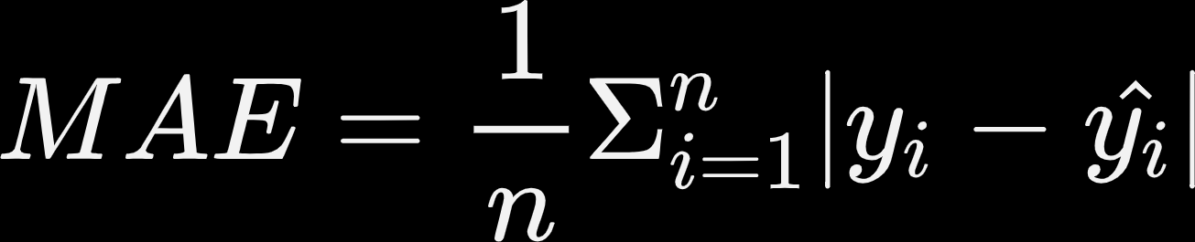

Model Evaluation: Squared Error Metrics
Mean Absolute Error (MAE):
Measures the average magnitude of the errors in a set of predictions, without considering their direction.
Root Mean Squared Error (RMSE):
Also known as the standard error of regression.
Measures the square root of the average of squared differences between prediction and actual observation.
RMSE gets bigger than MAE as the sample size increases.

Slide 29
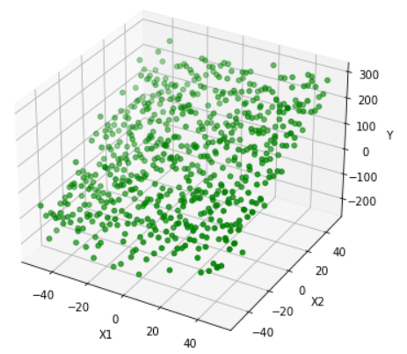
Suppose We’ve Got Some Generated Data…
How can we model the relationship between X1, X2, and Y?
Fig 3.4.1 Randomly-generated data in 3D

Slide 30
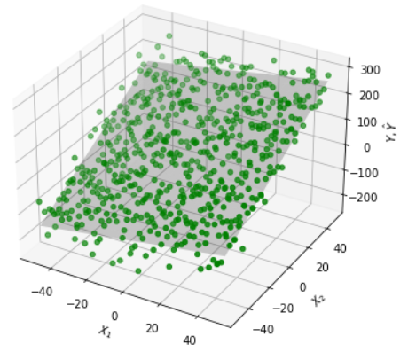
Suppose We’ve Got Some Generated Data…
Through a linear hyperplane whose function we can deduce. In other words, a multiple linear regression.
Fig 3.4.2 Randomly-generated data in 3D (with linear hyperplane)

Slide 31

Multiple Linear Regression
The multiple linear regression model defines a linear functional relationship between one continuous outcome variable and multiple input variables that takes on the following form:
In reality, multiple regression is more frequently used than simple regression because a dependent variable is rarely explained by only one variable. For instance, it takes more than just the oil price to explain the inflation in the economy.

Slide 32

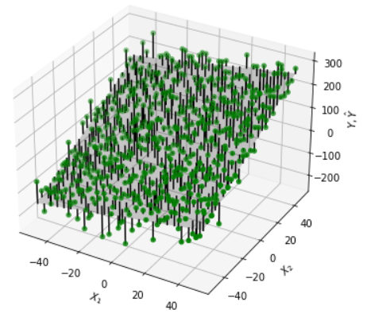
Fitting a Multiple Linear Regression
Fig 3.4.3 Multiple linear regression model fit

Slide 33
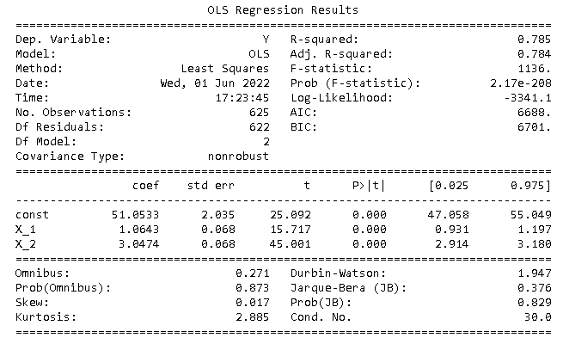
OLS Regression Result Summary
Fig 3.5 Multiple linear regression summary

Slide 34
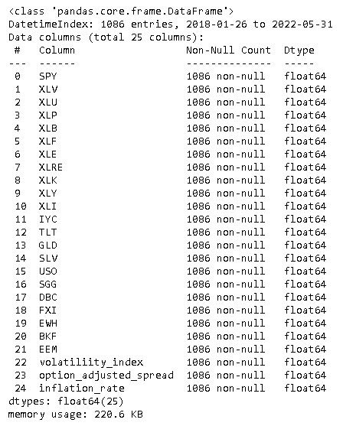
Predicting Returns with Linear Regression
Say you want to predict the performance of a the S&P 500 ETF (Ticker: SPY). You came up with a list of features ranging from sector and commodity ETFs to economic indicators for building your linear model.
You decided to observe performances of these features spanning from 1/26/2018 to 5/31/2022, for a total of 24 features and 1086 observations.
Features representing ETF log returns are labeled with letters; others are economic indicators with their own unit of measures.
The data structure is displayed on the right.
Note that we are looking at daily data and hence predicting in a daily timeframe.
Fig 3.6 Data set for predicting the S&P 500 ETF performance

Slide 35
Predicting Returns with Linear Regression - Data Pre-processing
Standardization:
Since each feature has a different unit of measure, for instance, XLK is measured in terms of log-return and volatility index is measured in its own index unit. We scale them so that they can be compared with the same units.
Feature Importance:
We use the Random Forest Regressor to compute the feature importance score for each of the proposed features, and found that only XLK and IYC log returns have importance score above 0.05, which show significance.
We keep these 2 features and drop the rest.
Multicollinearity:
We found that XLK and IYC log returns have equal VIFs of 4.415, hence showing moderate correlations. Since they are not considered to have high correlations (with the threshold of 5), we will keep them as our ultimate predictors for SPY log return.

Slide 36
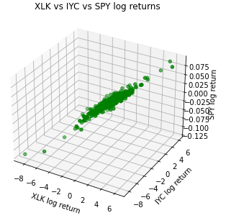
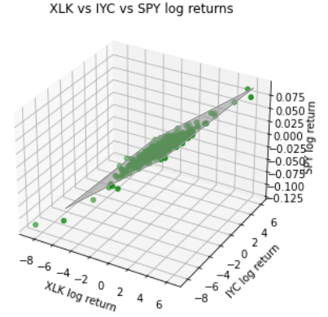
Predicting Returns with Linear Regression - Model Fitting
Before model fitting
After model fitting
Fig 3.7.1 Scatter plot before model fitting
Fig 3.7.2 Scatter plot after model fitting

Slide 37
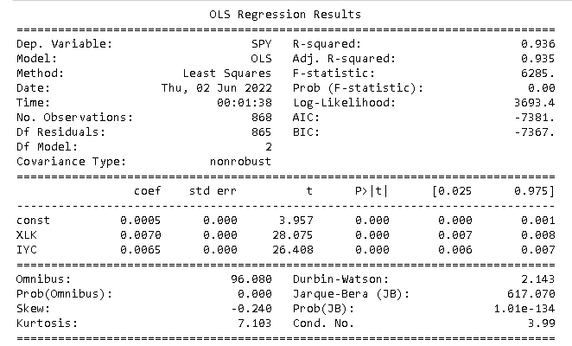
Predicting Returns with Linear Regression - Model Diagnostics
F-test: rejects the hypothesis that all coefficients are zero and irrelevant.
Skewness: slightly left skewed.
Kurtosis: fatter tails than a normal distribution, whose kurtosis is 3.
Jarque Bera tests: rejects the null hypothesis that the residuals are normally distributed.
Durbin-Watson test: fails to reject the hypothesis of no serial correlation in residuals.
Condition number: the value below 30 suggests that the regression doesn’t seem to have significant multicollinearity.
Fig 3.8 Multiple linear regression summary for predicting SPY log return

Slide 38
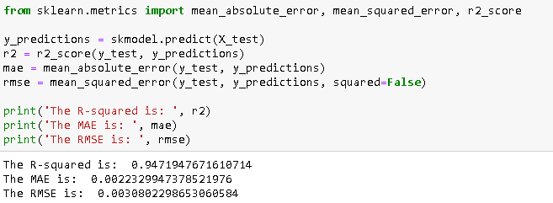
Predicting Returns with Linear Regression - Model Evaluation
R-squared
A 0.936 R-squared means that 93.6% of the variation in the observed SPY’s log returns is explained by this multiple linear regression model. Adjusted R-squared is 94.71%.
Mean Absolute Error (MAE):
On average, the distances of the predicted log returns for SPY from their actual observations is 0.0022.
Root Mean Squared Error (RMSE):
The square root of the average of squared differences between the SPY’s log return predictions and their actual observations is 0.0031.
Fig 3.9 R-squared, MAE, and MSE of the multiple linear regression on SPY log returns

Slide 39
Pros of Linear Regression
Model simplicity:
Linear regression model is the simplest equation denoting the relationship between the multiple predictor variables and predicted variable.
Computation Efficiency:
Modeling speed of linear regression is fast, even when predicting with a large amount of data, mainly because of the model’s simple structure.
Interpretability of the output:
Ability to determine the relative influence of one or more predictor variables to the predicted value when the predictors are independent of each other.

Slide 40
Cons of Linear Regression
Over-simplicity:
A simple model could be good for interpretability but often fails to capture real world complexity.
Linear assumptions:
Strong assumptions such as linearly-related dependent and independent variables are often not the case for real-world problems.
Effect of outliers:
Outliers can have a large effect on the output, as the line of best fit tries to minimize the MSE for the outlier points as well, resulting in a model that is not able to capture the information in the data.
Independence of variables:
THis assumption if often not true in real practice.
Homoskedacity assumption:
linear regression looks at a relationship between the mean of the dependent variable and the independent variables, then assumes constant variance around the mean which is unrealistic in most cases.

Slide 41
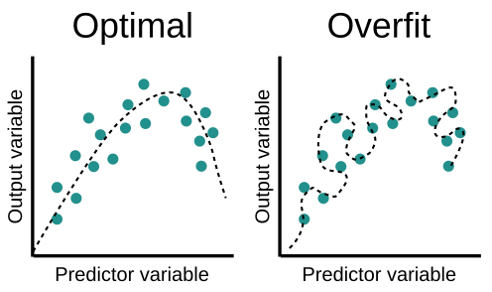
The Problem of Overfitting
Occurs when the model is "too complex". This usually happens when there is a large number of parameters compared to the number of observations.
Such a model is too ‘“tailor-made” to the old data and will not generalise well to new data, that is, it will perform well on training data, but poorly on test data.
Overfitting often occurs when the model has a high R-squared value.
These models have low bias and high variance.
Fig 3.10 Optimal vs overfit situations

Slide 42
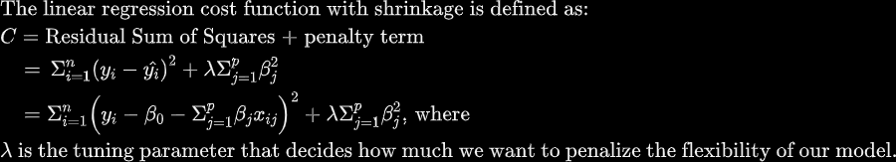

Regularization: Ridge Regression
A form of regression that shrinks the coefficient estimates towards 0, but not exactly 0.
It does so by adding a penalty term to the linear regression cost function.
Regularization discourages learning a more complex or flexible model to prevent overfitting.
Our goal is to estimate by minimizing this function. Estimates are called the L2 norm.
To minimize the cost function, the coefficients need to be small.

Slide 43
Pros & Cons of Ridge Regression
Pros:
Allows you to use complex models and avoid over-fitting at the same time.
Performs as well as OLS in a situation where you have a large multivariate data with the number of predictors (p) larger than the number of observations (n).
Useful to treat data features with multicollinearity.
Cons:
Decreases the complexity of a model but does not reduce the number of variables since it never set any of the coefficients to 0, but rather just minimizes them. So a variable that is insignificant for predicting the outcome will still be included in the model.

Slide 44
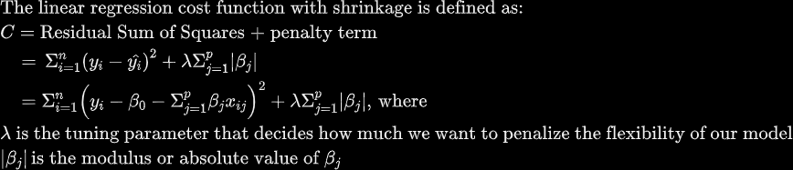
Regularization: Lasso Regression
A form of regression that only shrinks the high coefficient estimates.
Has the eﬀect of forcing some of the coeﬃcient estimates to be exactly equal to zero when the tuning parameter λ is suﬃciently large.This can help eliminate features with little to no contributions to our model.
Our goal is to estimate by minimizing this function - estimates are called the L1 norm.
To minimize the cost function, the coefficients need to be small.

Slide 45
Pros and Cons of Lasso Regression
Pros:
Tends to make coefficients to absolute zero, so that unimportant features can be dropped from the model, hence contributing to model simplicity.
More interpretable models.
Cons:
Sometimes struggles with some types of data. If the number of predictors (p) is greater than the number of observations (n), lasso regression will pick at most n predictors as non-zero, even if all predictors are relevant.
If there are two or more highly collinear variables then lasso regression selects one of them randomly which is not good for the interpretation of data.

Slide 46


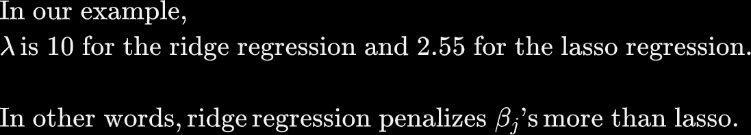
Regularization: How do we find the proper ?
We test a series of values and find the one that maximizes R-squared, then uses this in our cost function to estimate .
Grid Search Method:
Allow the machine to automatically propose a set of to test. In general, the larger the value, the stronger the regularization. You can also choose to pre-specify your own set of values, say numbers ranging from 0.0001 to 10000 but may run the risk of overfitting.
We can view these values on the x-axis and their corresponding R-squared values on the y-axis, then select the that yields the highest R-squared.

Slide 47
Regularization: Model Selection
After fitting both ridge regression and lasso regression to our ETF log return data, the result follows:
Model | Adjusted R-squared | MAE | RMSE
Multiple Linear Regression w/o regularization | 0.9470977717031379 | 0.002232989999824164 | 0.0030802222847201655
Ridge Regression | 0.947328679302916 | 0.002223367930381471 | 0.0030734926575553562
Lasso Regression | 0.9471914492062341 | 0.0022298195432703047 | 0.003077493898858937
Which model has the most optimal performance ?

Slide 48
Regularization: Model Selection
After fitting both ridge regression and lasso regression to our ETF log return data, the result follows:
Model | Adjusted R-squared | MAE | RMSE
Multiple Linear Regression w/o regularization | 0.9470977717031379 | 0.002232989999824164 | 0.0030802222847201655
Ridge Regression | 0.947328679302916 | 0.002223367930381471 | 0.0030734926575553562
Lasso Regression | 0.9471914492062341 | 0.0022298195432703047 | 0.003077493898858937
The answer is the Ridge Regression because it has the highest Adjusted R-squared, and lowest MAE and RMSE among the three models.

Slide 49
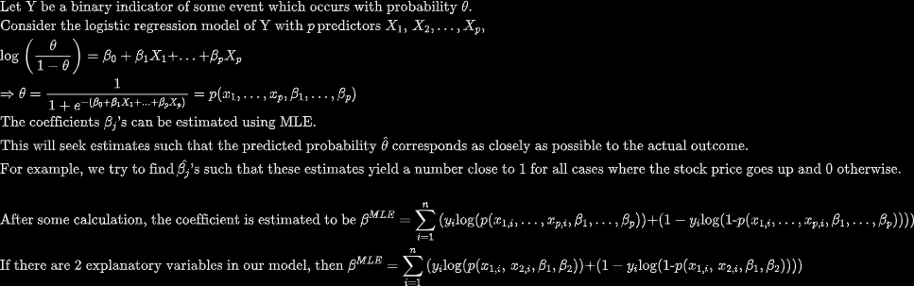
Logistic Regression (for classification)
Used to model the probabilities of the output classes, given a function that is linear in the explanatory variables, just like the linear regression model.
We illustrate the objective function below:

Slide 50
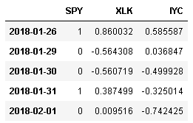
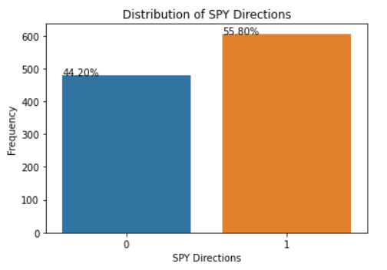
Predicting Asset Direction with Logistic Regression
Step 1: We convert the SPY log return into a binary variable, one that only take on values 0 and 1 - 0 represents a day with negative return (downward direction) and 1 represents a day with positive return (upward direction).
Fig 3.11 Binarized SPY return and its features
Step 2: Check for any label imbalances by plotting a bar plot of both labels. In our case, SPY yields a positive return on 55.8% of the trading days and a positive return on 44.2% of the trading days. This gives a minority-to-majority of 1:1.26, which is close to 1:1, so we don’t need to re-balance the labels.
Fig 3.12 SPY direction distribution

Slide 51

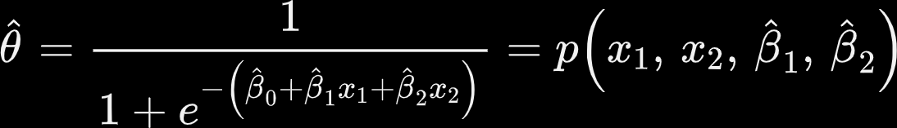
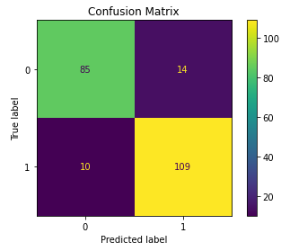
Predicting Asset Direction with Logistic Regression
Step 3: Now, we start fitting a logistic regression model on SPY directions. The model predicts using MLE and estimates the probabilities of class 1 using:
Step 4: Produce a confusion matrix.
Top left: shows the true positives (TP), number of correctly predicted downward days.
Top right: shows the false negatives (FN), number of downward days incorrectly predicted as upwards days
Bottom left: shows the false positives (FP), number of upward days incorrectly predicted as downward days
Bottom right: shows the true negatives (TN), number of correctly predicted upward days.
Fig 3.13 Confusion matrix of SPY directions

Slide 52

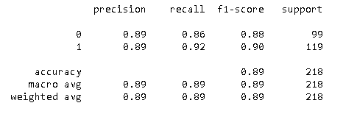
Predicting Asset Direction with Logistic Regression
Step 5: Produce precision, recall, F1 score, support, and accuracy details. These metrics are derived from the counts in the confusion matrix.
Fig 3.14 Logistic regression classification report

Slide 53

Predicting Asset Direction with Logistic Regression
Step 6: Calculate training and testing accuracy scores.
Fig 3.15 Training and testing accuracy scores
Step 7: Plot the ROC curve and evaluate the AUC scores.
Receiver Operator Characteristic (ROC) curve: a probability curve that plots the true positive rate against false positive rate at various threshold values and essentially separates the ‘signal’ from the ‘noise’.
ROC for a No-skill curve is simply that for a 50-50 chance classifier
The higher the model’s ROC curve lies from that the No-skill classifier, the higher the AUC, the better the model.
Area Under the Curve (AUC) score: the measure of the ability of a classifier to distinguish between positive and negative classes.
This is literally the areas under the ROC curve.
The higher the AUC score the better, normally between 0.5 and 1.
When AUC score is 0.5, then the classifier is not able to distinguish between Positive and Negative class points.

Slide 54
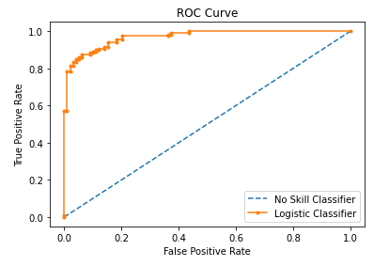

Predicting Asset Direction with Logistic Regression
A no-skill classifier is one that cannot discriminate between the classes and would predict a random class or a constant class in all cases. It has an AUC score of 0.5.
The logistic classifier has an AUC score of 0.97. We compare this to the AUC of other models to decide the best classifier.
We will look at more classification models next week.
Fig 3.15 ROC-AUC curve

Slide 55
Pros & Cons of Logistic Regression
Pros | Cons
Easier to implement, interpret, and very efficient to train. | If the number of observations (p) is smaller than the number of features (p), overfitting may occur.
Makes no assumptions about distributions of classes in feature space. | Assumption of linearity between the dependent variable and the independent variables.
Provides a measure of how appropriate a predictor(coefficient size) is, but also its direction of association (positive or negative). | Can only be used to predict discrete functions.
Very fast at classifying unknown records. | Non-linear problems can’t be solved with logistic regression because it has a linear decision surface.
Can interpret model coefficients as indicators of feature importance. | Requires average or no multicollinearity between independent variables, which is difficult to achieve in real life.
Less inclined to over-fitting but it can overfit in high dimensional datasets.T | It is tough to obtain complex relationships compared to other powerful algorithms such as Neural Networks .

Slide 56
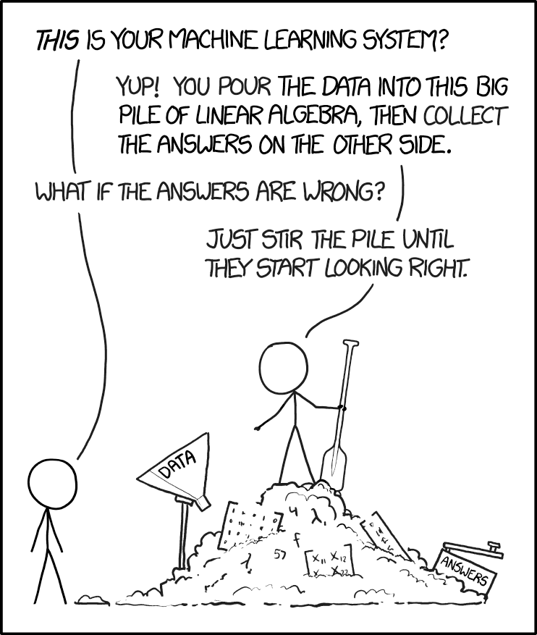
Summary
Bias-Variance Tradeoff
Linear Regression
Simple Linear Regression
Multiple Linear Regression
Estimation Methods
Ordinary Least Squares (OLS)
Maximum Likelihood Estimation (MLE)
Model Diagnostics
t and F Tests
Jarque-Bera Test
Durbin Watson Test
AIC & BIC
Model Evaluation
R-squared & Adjusted R-squared
MAE & RMSE
Regularization
Ridge Regression
Lasso Regression
Classification Problem with Logistic Regression

Slide 57
Week 3 Assignments
[Week 3 Lab Link Here]
This week’s lab is due by 24th July, 2022 (11:59 pm CDT )
3rd team meeting by 25th July, 2022 (11:59 pm CDT )
You are encouraged to discuss the lab with each other, but ultimately all questions must be solved and written up independently.
Any questions can be directed through email or through office hours.
Email Info
John Lee: lykjohn@umich.edu
Johnson Zhang: shunqi@uchicago.edu
Eric Lee: ericsclee@uchicago.edu
Office Hours Info:
Please email the course instructor/assistant to set an appointment.

